Slide 1

RESEARCH METHODOLOGY IN Psychology
BY: AQSA FAYYAZ
Lecturer
(Science and Humanities)
FAST - National University of Computer & Emerging Sciences

Slide 2
LEARNING OUTCOMES
What are scientific process?
Types of researches
Variables
Research Methods
Ethical Considerations in Research & applications of research

Slide 3

What is research?
Systematic Inquiry: Research follows a structured approach to collect and analyze information.
Knowledge Expansion: It seeks to generate new insights, confirm existing theories, or explore different areas.
Problem Solving: Research can address specific questions or issues, leading to practical solutions or advancements in a field.

Slide 4
Types of Research
Basic Research: Also known as fundamental or pure research, it focuses on expanding theoretical knowledge without immediate practical application. For example, studying cognitive processes to understand how memory works.
Applied Research: It aims to solve specific, practical problems and often involves direct application of theories. For instance, developing new educational strategies based on cognitive research.

Slide 5
Scientific process
1. Observation
2. Formulating a Hypothesis: Proposing a tentative explanation or prediction based on the observations. A hypothesis should be specific, testable, and falsifiable.
3. Designing an Experiment:
Planning how to test the hypothesis, including selecting variables, controls, and methods for data collection.

Slide 6
Variables:
Independent Variable: The variable that is manipulated or changed in the experiment.
Dependent Variable: The variable that is measured or observed to assess the effect of the independent variable.
Control Variables: Factors that are kept constant to ensure that any changes in the dependent variable are due to the manipulation of the independent variable.

Slide 7
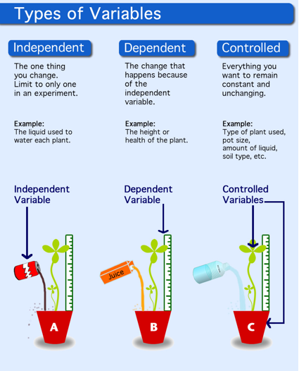

Slide 8
4. Conducting the Experiment
Execution: Performing the experiment according to the design, ensuring accurate and precise measurements and controls.
Data Collection: Systematically recording the results of the experiment.
5. Analyzing Data
Data Analysis: Using statistical methods or qualitative analysis to interpret the results and determine if they support or refute the hypothesis.
Comparison: Assessing the data against the predictions made by the hypothesis.

Slide 9
6. Drawing Conclusions
Conclusion Formulation: Based on the data analysis, determining whether the hypothesis is supported or rejected.
Implications: Discussing the significance of the findings, potential impacts, and how they relate to existing knowledge.
7. Reporting Results
Documentation: Writing detailed reports or papers that include the methodology, results, and conclusions. This often includes sharing the research in scientific journals or presentations.
Peer Review: Submitting the work for review by other experts in the field to validate the findings and methodology.

Slide 10
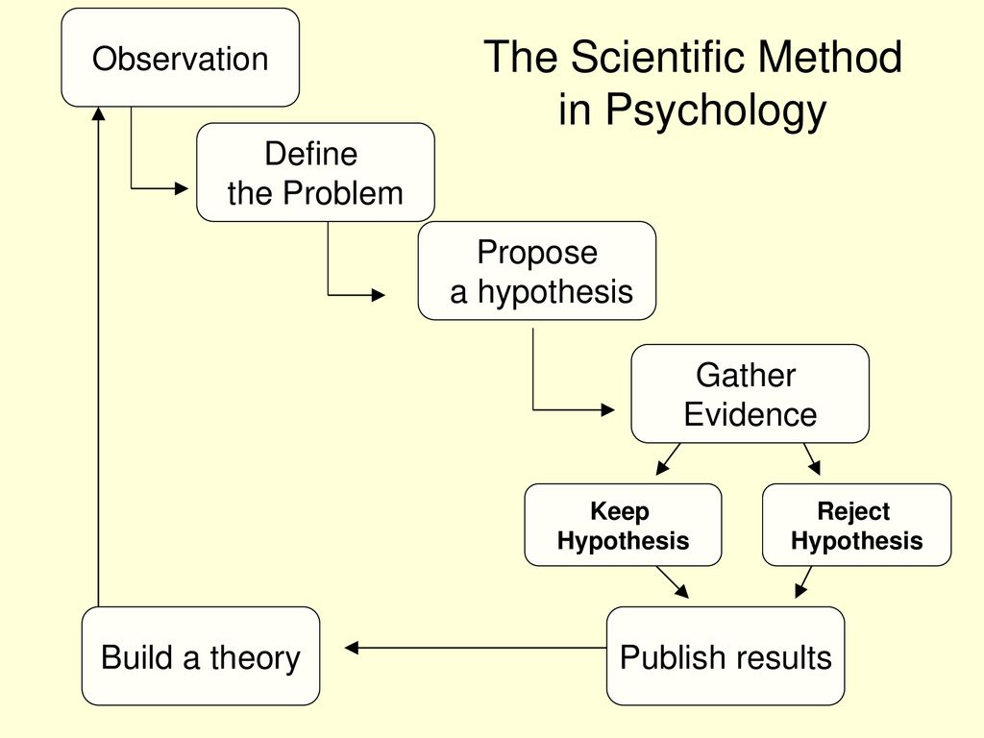

Slide 11
Research Process
Identifying a Problem or Question: Defining a clear and focused research question or problem.
Conducting a Literature Review: Reviewing existing research to understand what has already been discovered and to refine the research question.
Designing the Study: Developing a plan that includes choosing a research design, methods, and tools for data collection.
Collecting Data: Gathering information through various methods such as experiments, surveys, interviews, or observations.
Analyzing Data: Using statistical or qualitative methods to interpret the data and draw conclusions.
Reporting Results: Presenting findings in a structured format, often including a discussion of implications and recommendations.

Slide 12
Research Methodologies
Qualitative Research: Focuses on understanding phenomena from a subjective perspective, often using methods like interviews, thematic analysis and case study researches
Quantitative Research: Involves measuring and analyzing numerical data to identify patterns, relationships, or causal effects, using statistical techniques.
Mixed Methods Research: Combines both qualitative and quantitative approaches to provide a comprehensive analysis.

Slide 13
Ethical Considerations
Informed Consent: Ensuring participants are aware of the research and agree to participate voluntarily.
Confidentiality: Protecting the privacy of participants and their data.
Integrity: Conducting research honestly and accurately, avoiding fabrication or falsification of data.

Slide 14
Applications of Research
Academic and Scientific: Contributing to the body of knowledge in various fields such as psychology, medicine, or sociology.
Professional and Practical: Informing practices and policies in areas like education, healthcare, or business.

